Slide 1

Liver Tumor Segmentation Model
Faizan (FA21-BSE-011)
Fawad Iqbal (FA21-BSE-012)
Dr. Mubashir Ahmad
Department of Computer Science
COMSATS University Islamabad, Abbottabad Campus

Slide 2
Agenda of the Presentation
Introduction
Scope
Functional Requirements
Non-Functional Requirements
User Goals
Use Cases
Demonstration (Preprocessing Implementation)
Q&A

Slide 3
Brief Introduction
For our 30% milestone, we focused on the preprocessing phase of the liver tumor segmentation system. Specifically:
Data Handling: We worked with the LITS17 dataset, converting 3D CT scans into 2D slices for computational efficiency.
Preprocessing: Applied intensity thresholding to isolate the liver region and ensure meaningful patches are extracted.
Feature Extraction: Implemented convolutional layers to process 2D slices, extracting features and generating patches for the attention layers of nnFormer.
System Integration: Passed preprocessed data through the encoder, laying the foundation for segmentation tasks.

Slide 4
Scope
What to Do:
Data Preprocessing: Convert 3D CT scans into 2D slices.
Intensity Thresholding: Focus on extracting relevant liver regions from the scans.
Feature Extraction: Use convolutional layers to extract features and generate patches for attention mechanisms.
Pipeline Integration: Pass preprocessed data to the nnFormer encoder for further processing.
Visualization: Display segmented results for analysis and evaluation.
Dashboard Development: Create a user-friendly interface for uploading and displaying CT scans and results.

Slide 5
Scope Cont.…
What Not to Do:
Model Training: Avoid training the nnFormer at this stage; focus on preprocessing and feature extraction.
Full 3D Segmentation: Do not aim for complete 3D segmentation due to resource constraints.
Unrefined Data Inputs: Do not input raw data directly into the segmentation model without preprocessing.
Complex Frontend Design: Avoid overcomplicating the dashboard interface at this stage. Keep it simple and functional.
Ignore Visualization: Do not neglect presenting clear results, as they are key for validation and analysis.

Slide 6
Functional Requirements
Preprocess 3D CT scans into 2D slices.
Apply intensity thresholds to identify the liver region.
Pass preprocessed 2D slices to the nnFormer encoder.
Extract convolutional features and generate patches for attention layers.
Visualize segmentation outputs and analyze results.
Provide a user-friendly dashboard for uploading and displaying CT scans.

Slide 7
Non-Functional Requirements
Performance: Efficient preprocessing of CT scans and patch extraction.
Scalability: Future-proof to handle larger datasets and 3D processing.
Reliability: Consistent and error-free conversion of 3D CT scans to 2D slices.
Usability: Simple and intuitive upload and visualization of CT scan data.
Maintainability: Modular, well-documented code for easy future updates.
Compatibility: Works seamlessly with Python libraries and Google Colab environment.

Slide 8
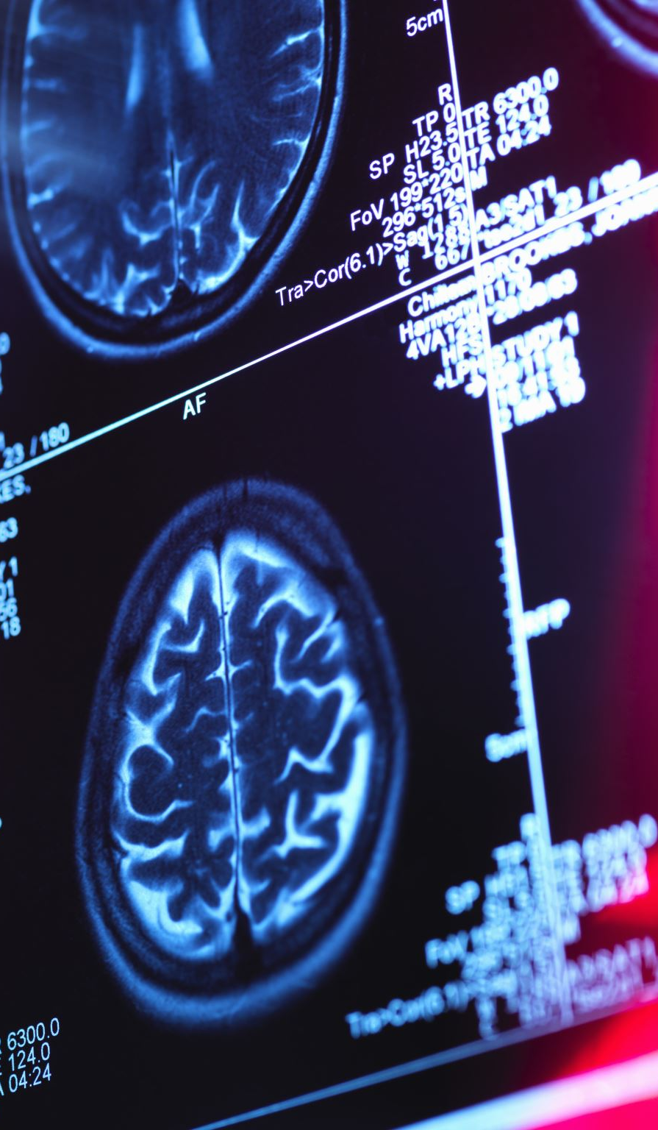
User Goals
Efficient Data Preprocessing:
Convert 3D CT scans into 2D slices for analysis.
Accurate Liver and Tumor Segmentation:
Prepare data for nnFormer segmentation, focusing on patch extraction and feature processing.
User-Friendly Interface:
Provide a simple dashboard for uploading and visualizing CT scan data.
Data Integrity:
Ensure the extracted patches and processed data maintain accuracy for further model training.

Slide 9
Use Cases
Upload CT Scan
User uploads a 3D CT scan to the system.
System preprocesses the scan into 2D slices.
Liver Region Extraction
System applies intensity thresholds to extract the liver region from the CT scan.
Patch Extraction
Extract 2D patches from the liver region for further processing.
Segmentation Data Preparation
Prepare the preprocessed data and patches for nnFormer encoder to capture relevant features for tumor segmentation.
Visualization
Display the extracted liver region and segmentation results in the dashboard for user review.

Slide 10
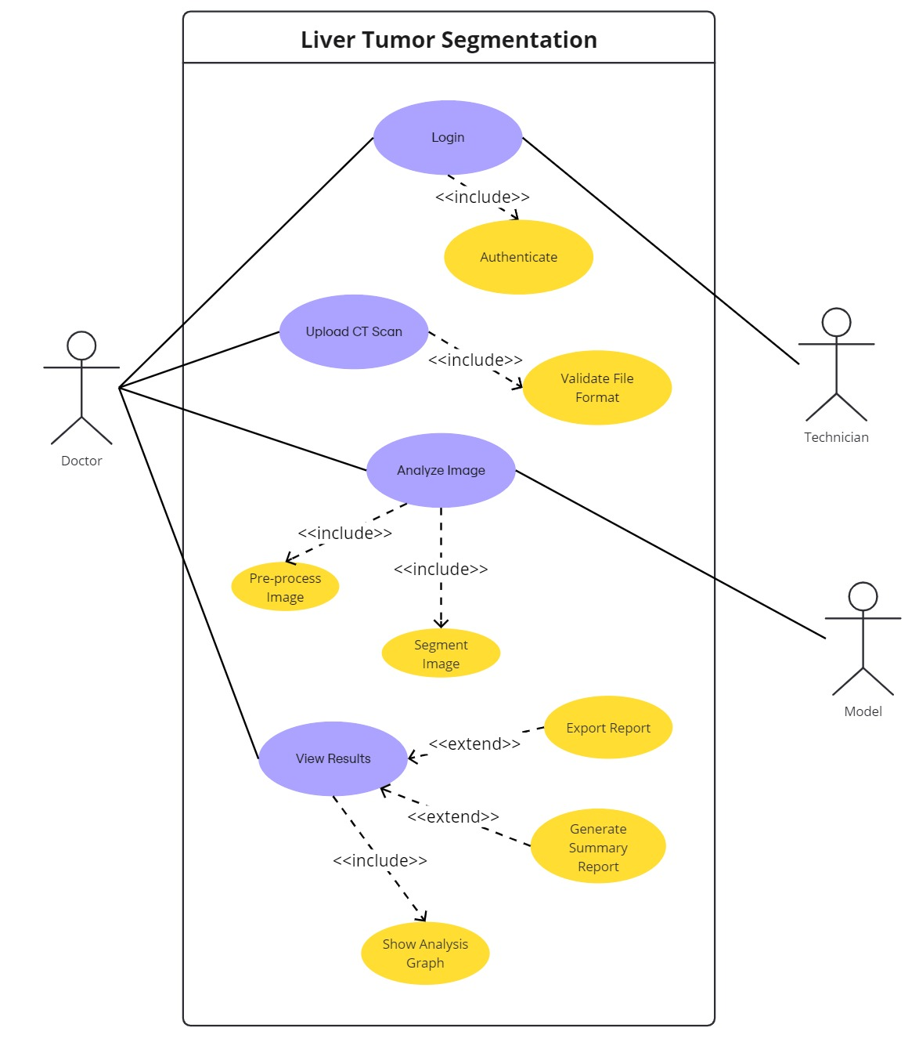
Use Case Diagram

Slide 11
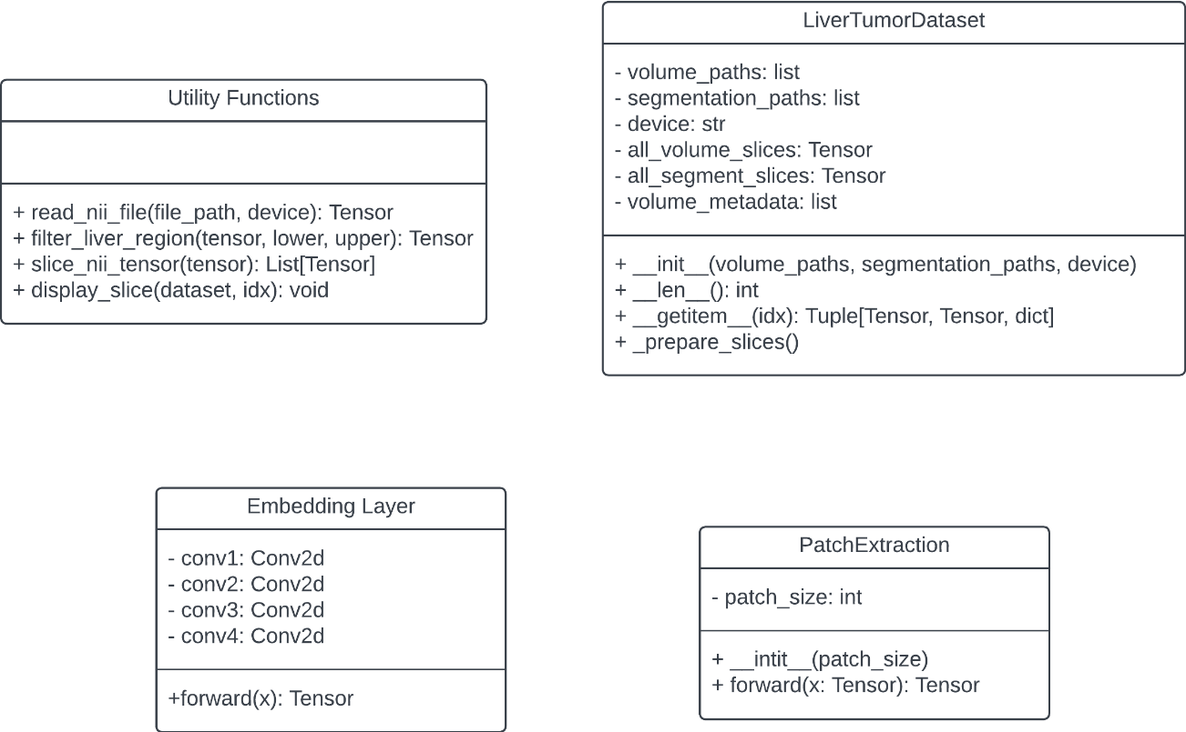
Class Diagram

Slide 12
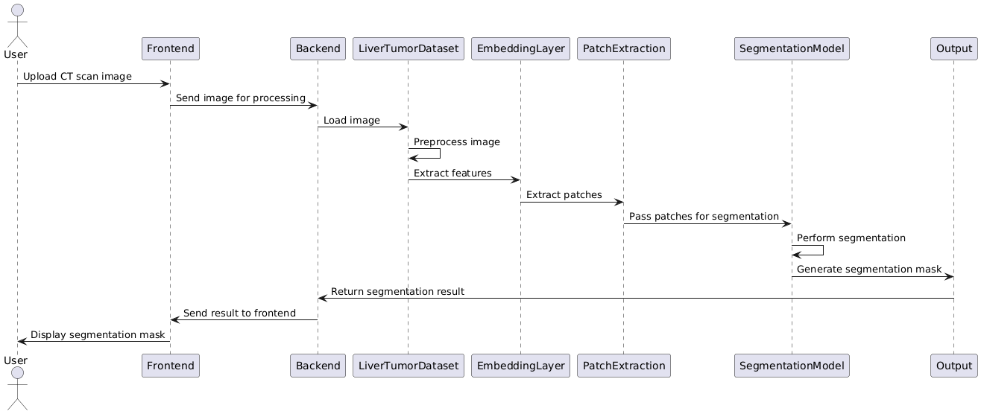
Sequence Diagram

Slide 13
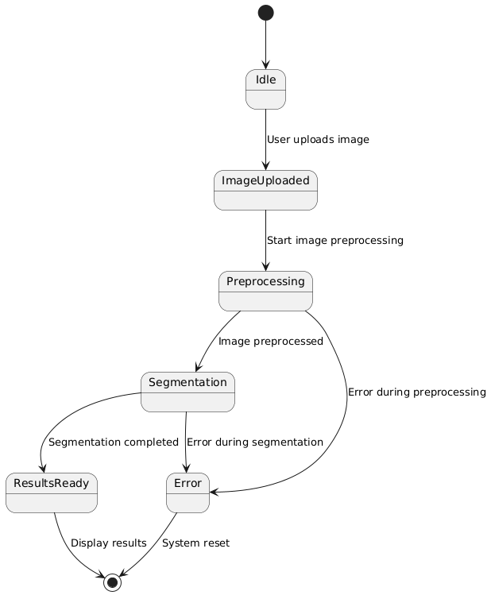
State Transition Diagram

Slide 14
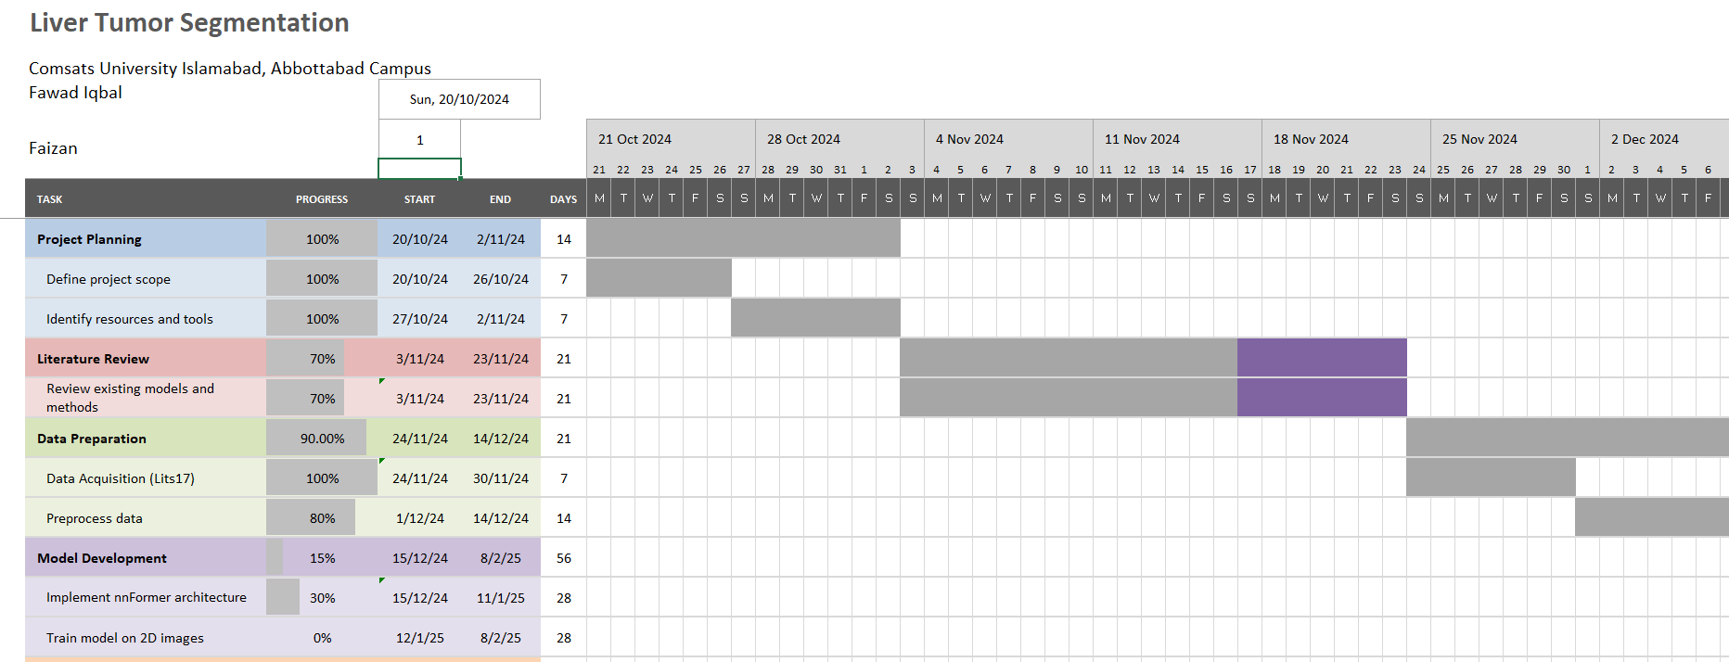
Schedule

Slide 15
Details of 1st Iteration (30%)
nnFormer Encoder Implementation:
Successfully implemented the encoding part of the nnFormer architecture.
Encoder processes the input data, extracting essential features.
Patch Preparation:
3D CT images have been converted into 2D patches.
Patches are ready for feeding into the nnFormer model.

Slide 16
Details of 2nd Iteration (60%)
Model Training: Train the nnFormer model on prepared patches for liver tumor segmentation.
Evaluate performance and fine-tune the model.

Slide 17
Conclusion
So far, we have completed the initial stages of the project, including the implementation of the encoder part of the nnFormer architecture. Additionally, we have prepared and processed the 2D patches from 3D CT images, making them ready for feeding into the nnFormer model.
This forms the foundation for the next steps in the project, where we will focus on training the model and evaluating its performance. These early achievements have set the stage for building a robust liver tumor segmentation system.

